Slide 1
CSE 1102 Fundamentals of Programming Lecture #8
Spring 2017
Computer Science & Engineering Program
School of Electrical Engineering & Computing
Adama Science & Technology University

Slide 2
Branching and Looping Practice
Loop Programming Techniques
Practice if statements
Assignment #2: Heat Transfer
General Math and Science Problems
Drawing Patterns with Nested For Loops
Recursion vs. Iteration
Solving Trigonometry using Infinite/Truncated Series

Slide 3
Loop Programming Techniques
These techniques are suitable for pretest loops (for and while):
Interactive input within a loop
Includes a cin statement within a while or for loop
Selection within a loop
Using a for or while loop to cycle through a set of values to select those values that meet some criteria

Slide 4
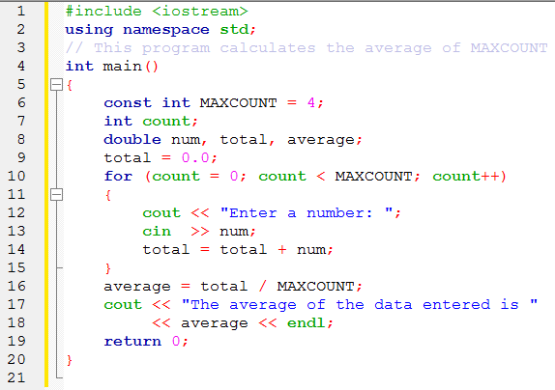
Interactive Input within a Loop

Slide 5
Selection in a Loop

Slide 6
Evaluating Functions of One Variable

Slide 7
Loop Programming Techniques
Interactive loop control
Variable is used to control the loop repetitions
Provides more flexibility at run-time
Random numbers and simulation
Pseudorandom generator used for simulators
C++ functions: rand(); srand()

Slide 8
Interactive Loop Control

Slide 9
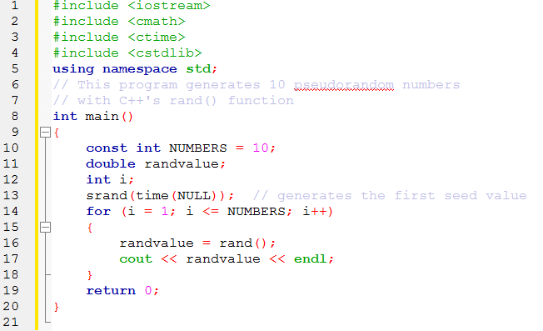
Random Number and Simulation
Example #1

Slide 10
Random Number and Simulation
Example #2 : The Algorithm
Initialize a heads count to 0
Initialize a tails count to 0
For 1000 times
Generate a random number between 0 and 1
If the random number is greater than 0.5
consider it a head and add 1 to the heads count
Else
consider it a tail and add 1 to the tails count
End If
End For
Calculate the percentage of heads as the number of heads ÷ 1000 × 100%
Calculate the percentage of tails as the number of tails ÷ 1000 × 100%
Print the percentage of heads and tails calculated

Slide 11
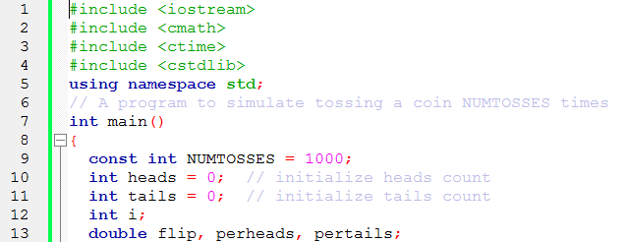
Random Number and Simulation
Example #2: Source Code

Slide 12
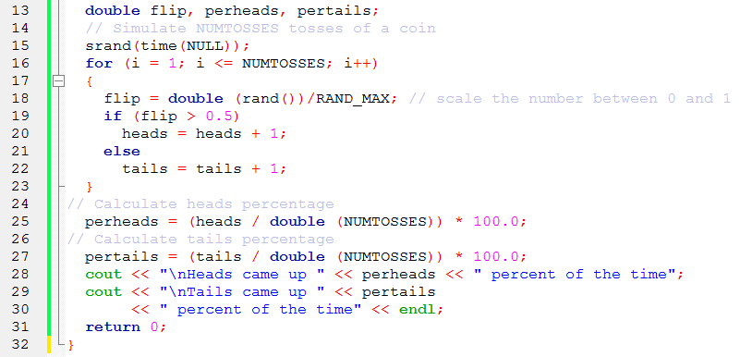
Random Number and Simulation
Example #2: Source Code

Slide 13
Practice if statements
Write appropriate if statements for the following conditions
If the temperature is above 100 degrees, display the message “above the boiling point of water”; else, display the message “below the boiling point of water.”
If the number is positive, add the number to the variable positivesum ; else, add the number to the variable negativesum .
If the difference between volts1 and volts2 is less than 0.001, set the variable approx to 0; else, calculate approx as the quantity (volts1 - volts2) / 2.0.

Slide 14
General Math and Science Problems
A student’s letter grade is calculated according to the following schedule:
Using this information, write a C++ program that accepts a student’s numerical grade, converts the numerical grade to an equivalent letter grade, and displays the letter grade.
Numerical Grade | Letter Grade
Greater than or equal to 90 | A
Less than 90 but greater than or equal to 80 | B
Less than 80 but greater than or equal to 70 | C
Less than 70 but greater than or equal to 60 | D
Less than 60 | F

Slide 15
General Math and Science Problems
Modify the previous program
Use switch statement
Based on the obtained letter grade of a student display comment
Letter Grade | Comment
A | Excellent
B | Very Good
C | Good
D | Poor
F | Fail

Slide 16
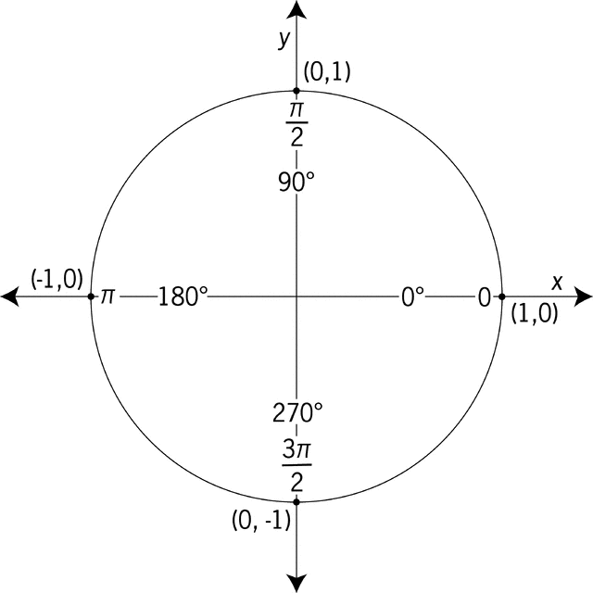
General Math and Science Problems
Write a C++ program that accepts the angle of the line as user input
determine and display
the correct quadrant for
the input data.
Note : If the angle is exactly 0, 90, 180, or 270 degrees, the corresponding line doesn’t reside in any quadrant but lies on an axis.
Angle from the Positive X-Axis | Quadrant
Between 0 and 90 degrees | I
Between 90 and 180 degrees | II
Less than 180 but greater than or equal to 270 degrees | III
Less than 270 but greater than or equal to 360 degrees | IV

Slide 17
Assignment #2: Heat Transfer
The transfer of heat by the movement (currents) of a gas or liquid is referred to as heat convection.
The heat transferred per unit area of a substance is given by this formula
$$q=hA(T_{s}{−T}_{a})$$
q is the heat transfer rate (watts or Joules/sec).
h is the convective heat transfer coefficient
$BTU/hr−ft℉ or watts/m^{2}℃$)
A is the surface area (ft² or m²).
T_{s} is the surface temperature (°F or °C).
T_{a} is the ambient temperature (°F or °C).
-Heat Transfer Notes
http://www.freestudy.co.uk/heat%20transfer/

Slide 18
Assignment #2: Heat Transfer
The program should
accept a substance’s surface area,
a substance’s surface temperature
the ambient air temperature as inputs and
displays the heat transfer rate through air
Users should have three choices for entering the surface area:
A rectangular area
An elliptical area
Other

Slide 19
Assignment #2: Heat Transfer
If the user selects 1
the program should ask the user to enter the surface’s length and width,
and the program calculates surface area as length times width.
If the user selects 2,
the program should ask the user to enter the surface’s major and minor axis,
and the program calculates the surface area as π(major axis)(minor axis).
If the user selects 3 (Other),
the program should ask the user to enter the surface area.

Slide 20
Assignment #2: Heat Transfer
The heat transfer rate should then be calculated and displayed, using the convective heat transfer coefficient of 8.7 watts/m² °C, which should be defined as the symbolic constant AIRCONV.
As a test case
determine the heat transfer rate away from a chip in a computer’s console.
The chip has a surface temperature of 44°C, and the ambient temperature maintained by the console’s fan is 40°C.
The rectangular chip has a length of 2 cm and a width of 2 cm.

Slide 21
Drawing Patterns with Nested For Loops
Write a program that uses for statements to print the following patterns separately, one below the other. Use for loops to generate the patterns.
All asterisks(*) should be printed by a single statement of the form cout << '*';
(this causes the asterisks to print side by side). [Hint: The last two patterns require that each line begin with an appropriate number of blanks.

Slide 22
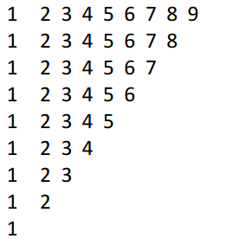
Drawing Patterns with Nested For Loops
Write a program that create the following number patterns.

Slide 23
Recursion vs. Iteration(Loops)
Recursion is defining something in terms of itself. It sounds a bit odd, but very natural in fact.
Common Examples are
Factorial of a Number and
Fibonacci Numbers

Slide 24
Recursion vs. Iteration(Loops)
In mathematics, the factorial function is defined as follows:
f(n) = n X (n-1) X (n-2) X……….X 2 X 1
(n – 1)!
f(n – 1)
1 if n = 1 base case
n x f(n - 1) if n > 1 recursive case
f(n)
f(n) =

Slide 25
Factorial: Using Recursion

Slide 26
Factorial: Using Recursion
Fact(5)
120
5*
Fact(4)
24
4*
Fact(3)
6
3*
Fact(2)
2
2*
Fact(1)
1

Slide 27
Factorial: Using Iteration

Slide 28
Fibonacci Numbers
Fibonacci numbers
n f(n)
0 1
1 1
2 2
3 3
4 5
5 8
6 13
…… ……
1 if n = 0
1 if n = 1
f(n – 1) + f(n - 2)
base case
f(n)
recursive case

Slide 29
Fibonacci Numbers
Fib(5)
8
Fib(4)
5
Fib(3)
3
Fib(3)
3
Fib(2)
2
Fib(2)
2
1
2
Fib(2)
1
1
1
1
1
1
1

Slide 30
Fibonacci Numbers
Write a c++ program to calculates the n^{th} Fibonacci number
Recursively
Iteratively

Slide 31
Solving Trigonometry using Series
A trigonometric function can be represented by an infinite series.
For example, the infinite series of sin x is
$\sin{x=x−\frac{x^{3}}{3!}}$+$\frac{x^{5}}{5!}$+$\frac{x^{7}}{7!}=\sum_{n=1}^{∞}{{(−1)}^{n−1}}\frac{x^{2n−1}}{\left(2n−1\right)!}$
Where x is in unit of radian -$∞$<x< $∞$

Slide 32
General Math and Science Problems
Since a computer cannot sum up the infinite number of terms in the series
the infinite series is truncated after a finite number of terms.
The truncated series, therefore, can only calculate the function to the precision of the floating point on the computer.
The truncated infinite series for sin
$$sinx=\sum_{n=1}^{N}{{(−1)}^{n−1}}\frac{x^{2n−1}}{\left(2n−1\right)!}$$
Where N is the number of terms to be retained in the series.

Slide 33
Solving Trigonometry using Series
Write a c++ program that:
Reads in a value of x in degrees and then calculates the sine of x using the sin built in function .
Next calculate the sine of x using above truncated infinite series to the prescribed accuracy (N)
which should be input by the user.
Output the values of the sine of x calculated using both intrinsic function and the truncated series, and the number of terms of the truncated series required.

